Slide 1



Amazon Sales Analysis.
By Mallula Ganesh.

Slide 2

Introduction
In today's highly competitive e-commerce landscape, understanding sales performance is crucial for driving growth and optimizing strategies. This presentation focuses on a comprehensive analysis of Amazon sales data, aiming to uncover valuable trends and insights that can inform business decisions.
Objectives:
To analyze sales patterns and identify key trends.
To understand the factors influencing sales performance.
To provide actionable insights for improving sales strategies.

Slide 3



Scope of Analysis:
Sales volume and revenue trends over time.
Product category performance.
Customer purchasing behavior
.Seasonal impacts and promotional effectiveness.
Data Sources:
The analysis is based on a dataset comprising Amazon sales records, including transaction details, product information,Units Sold, Unit Price, Unit Cost, Total Revenue, Total Cost ,Total Profit from the year 2010 to 2017

Slide 4

Methodology used in the analysis
Using a combination of descriptive statistics, trend analysis, and data visualization techniques, we will delve into the sales data to extract meaningful patterns and correlations. Advanced analytics tools such as Python and Excel were employed to ensure accuracy and depth in our findings.

Slide 5

Sales Trend’s
Understanding sales trends is essential for any business aiming to stay competitive and meet market demands effectively. Sales trends refer to the patterns and changes in sales performance over a specific period. Analyzing these trends helps businesses identify growth opportunities, anticipate market shifts, and make data-driven decisions.
Importance of Sales Trends Analysis:
Forecasting: Accurate sales forecasting to better plan inventory, staffing, and marketing efforts.
Strategy Optimization: Developing targeted marketing and sales strategies based on trend insights.
Resource Allocation: Efficiently allocating resources to areas with the highest potential for growth.
Competitive Advantage: Staying ahead of competitors by quickly adapting to changing market conditions.

Slide 6
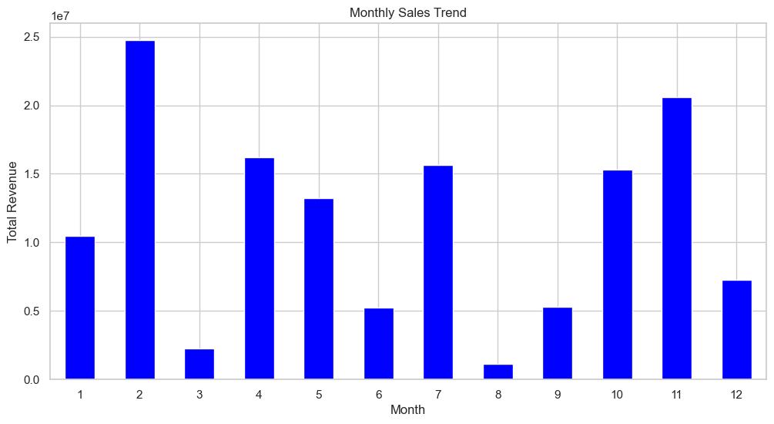
Monthly Sales Trend.

Slide 7
Monthly Sales Trend analysis.
Introduction:
Effective sales management hinges on a deep understanding of sales trends. It not only enhances decision-making and resource allocation but also empowers sales teams to perform at their best. By leveraging insights from sales trends, businesses can navigate challenges, capitalize on opportunities, and ultimately drive sustained growth and profitability.
Data Preparation:
Loaded the dataset.
Converted 'Order Date' to datetime format for easy extraction of month and year.
Visualization:
Used a bar plot to represent the monthly sales trend.
The plot shows how sales vary month-to-month, highlighting peak sales periods and off-seasons.

Slide 8
Key Findings in Monthly sales Trend.
1 Seasonal Variations:
Certain months show significantly higher sales, indicating peak sales periods.
Identify the months with the highest and lowest sales to understand seasonal demand.
2 Consistent Patterns:
Look for consistent patterns across months that repeat annually.
These patterns can help in planning marketing campaigns and stock management.
3 Growth Opportunities:
Identify months with relatively lower sales.
Analyze these periods for potential growth opportunities, such as targeted promotions or new product launches.

Slide 9
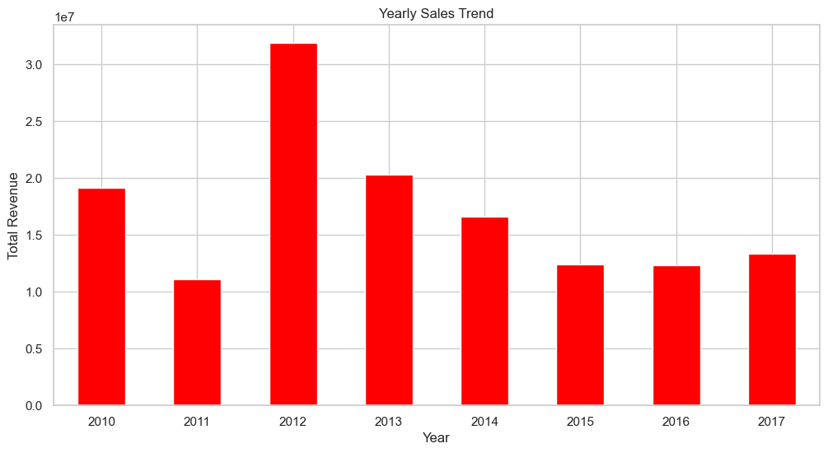
Yearly Sales Trend.

Slide 10
Yearly Sales Trend analysis.
Introduction:
Effective sales management hinges on a deep understanding of sales trends. It not only enhances decision-making and resource allocation but also empowers sales teams to perform at their best. By leveraging insights from sales trends, businesses can navigate challenges, capitalize on opportunities, and ultimately drive sustained growth and profitability.
Data Preparation:
Grouped the data by 'Order Year' and sum the 'Total Revenue' for each year.
The result is a new DataFrame, yearly_sales, containing the total revenue for each year.
Visualization:
Used a bar plot to represent the yearlyy sales trend.
Convert the 'Order Date' column to datetime format to facilitate date manipulations.
Extract the year from 'Order Date' to create a new column, 'Order Year', which will be used for aggregation.

Slide 11
Key Findings in Yearly sales Trend.
1 Growth Trend :
Observe the overall trend in sales over the years. A consistent upward trend indicates a growing business, while a downward or flat trend might require further investigation.
2 Impact of External Factors:
Identify any significant drops or spikes in sales corresponding to external factors such as economic downturns, market changes, or company-specific events.
3 Yearly Performance:
Compare performance year over year to understand growth rates and identify successful periods.

Slide 12
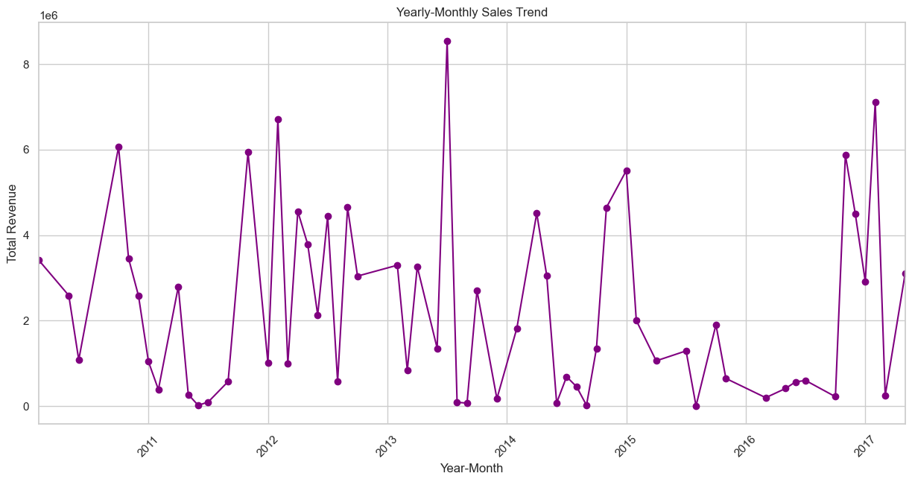
Yearly-Monthly Sales Trend.

Slide 13
Key Findings in Yearly-Monthly sales Trend.
1 Detailed Trends:
Provides a more granular view of sales trends by combining both yearly and monthly data.
2 Seasonal Impact Over Years:
Compare how specific months perform across different years. For example, comparing December sales across multiple years can indicate if holiday promotions are increasingly effective.
3 Sales Stability::
Understand the stability of sales throughout the year and across different years, which can help in forecasting and planning.

Slide 14
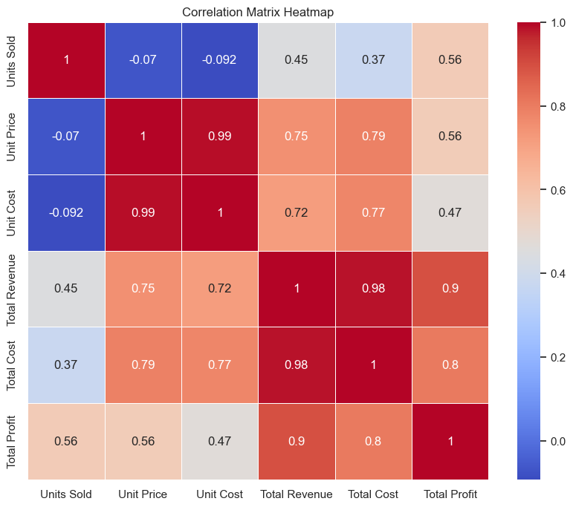
Correlation Analysis

Slide 15

Correlation key Findings.
Strong Positive Correlation between Total Revenue and Total Profit
Units Sold is Positively Correlated with Total Revenue and Total Profit
Positive Correlation between Unit Price and Revenue Per Unit
Unit Cost is Strongly Positively Correlated with Total Cost
Negative Correlation between Profit Margin and Unit Cost
Revenue Per Unit and Profit Per Unit Show Positive Correlation
Moderate Positive Correlation between Units Sold and Total Cost
Profit Margin and Total Profit Show Positive Correlation

Slide 16
Conclusion:
1. Comprehensive Understanding of Sales Dynamics:
The analysis provided a detailed insight into how various factors such as region, country, item type, and sales channel affect sales and profitability.
2. Key Drivers of Revenue and Profit:
Units Sold and Unit Price were identified as primary drivers of Total Revenue and Total Profit.
Effective strategies to increase sales volume and optimize pricing can significantly boost overall performance.
3. Impact of Costs on Profit Margins:
Unit Cost plays a critical role in determining profit margins.
Reducing unit costs can enhance Profit Margins and Total Profit, emphasizing the need for cost management.

Slide 17
4. Correlation Insights:
Strong correlations between Total Revenue and Total Profit underscore the importance of revenue generation strategies.
Negative correlation between Unit Cost and Profit Margin indicates cost efficiency as a key area for improving profitability.
5. Recommendations for Action:
Focus on High-Growth Regions: Target marketing efforts and resources towards regions with the highest sales potential.
Product Portfolio Optimization: Invest in and promote items with higher profit margins.
Cost Management Strategies: Implement measures to reduce unit costs and improve operational efficiency.
Dynamic Pricing Strategies: Adjust pricing strategies to maximize revenue per unit sold.
6. Future Analysis:
Continued data analysis and monitoring to adapt to changing market trends and customer preferences.
Use advanced predictive analytics to forecast sales and optimize supply chain operations.

Slide 18
Closing Statement:
The data-driven insights from this analysis provide a solid foundation for making informed decisions to drive Amazon's sales and profitability.
By leveraging these insights, Amazon can enhance its competitive edge, meet customer demands more effectively, and achieve sustained growth.

Slide 19

Thank you very much!
Presented by Mallula Ganesh

